Slide 1
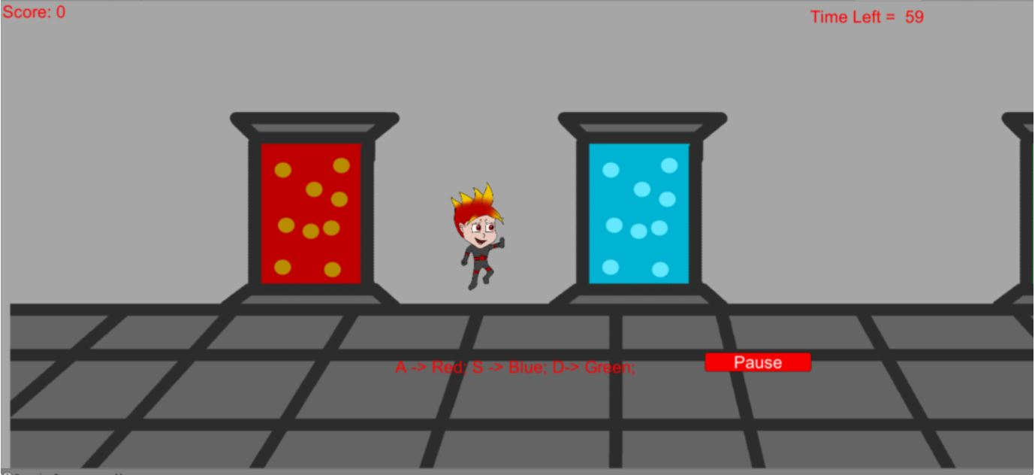
Nova sirius

Slide 2
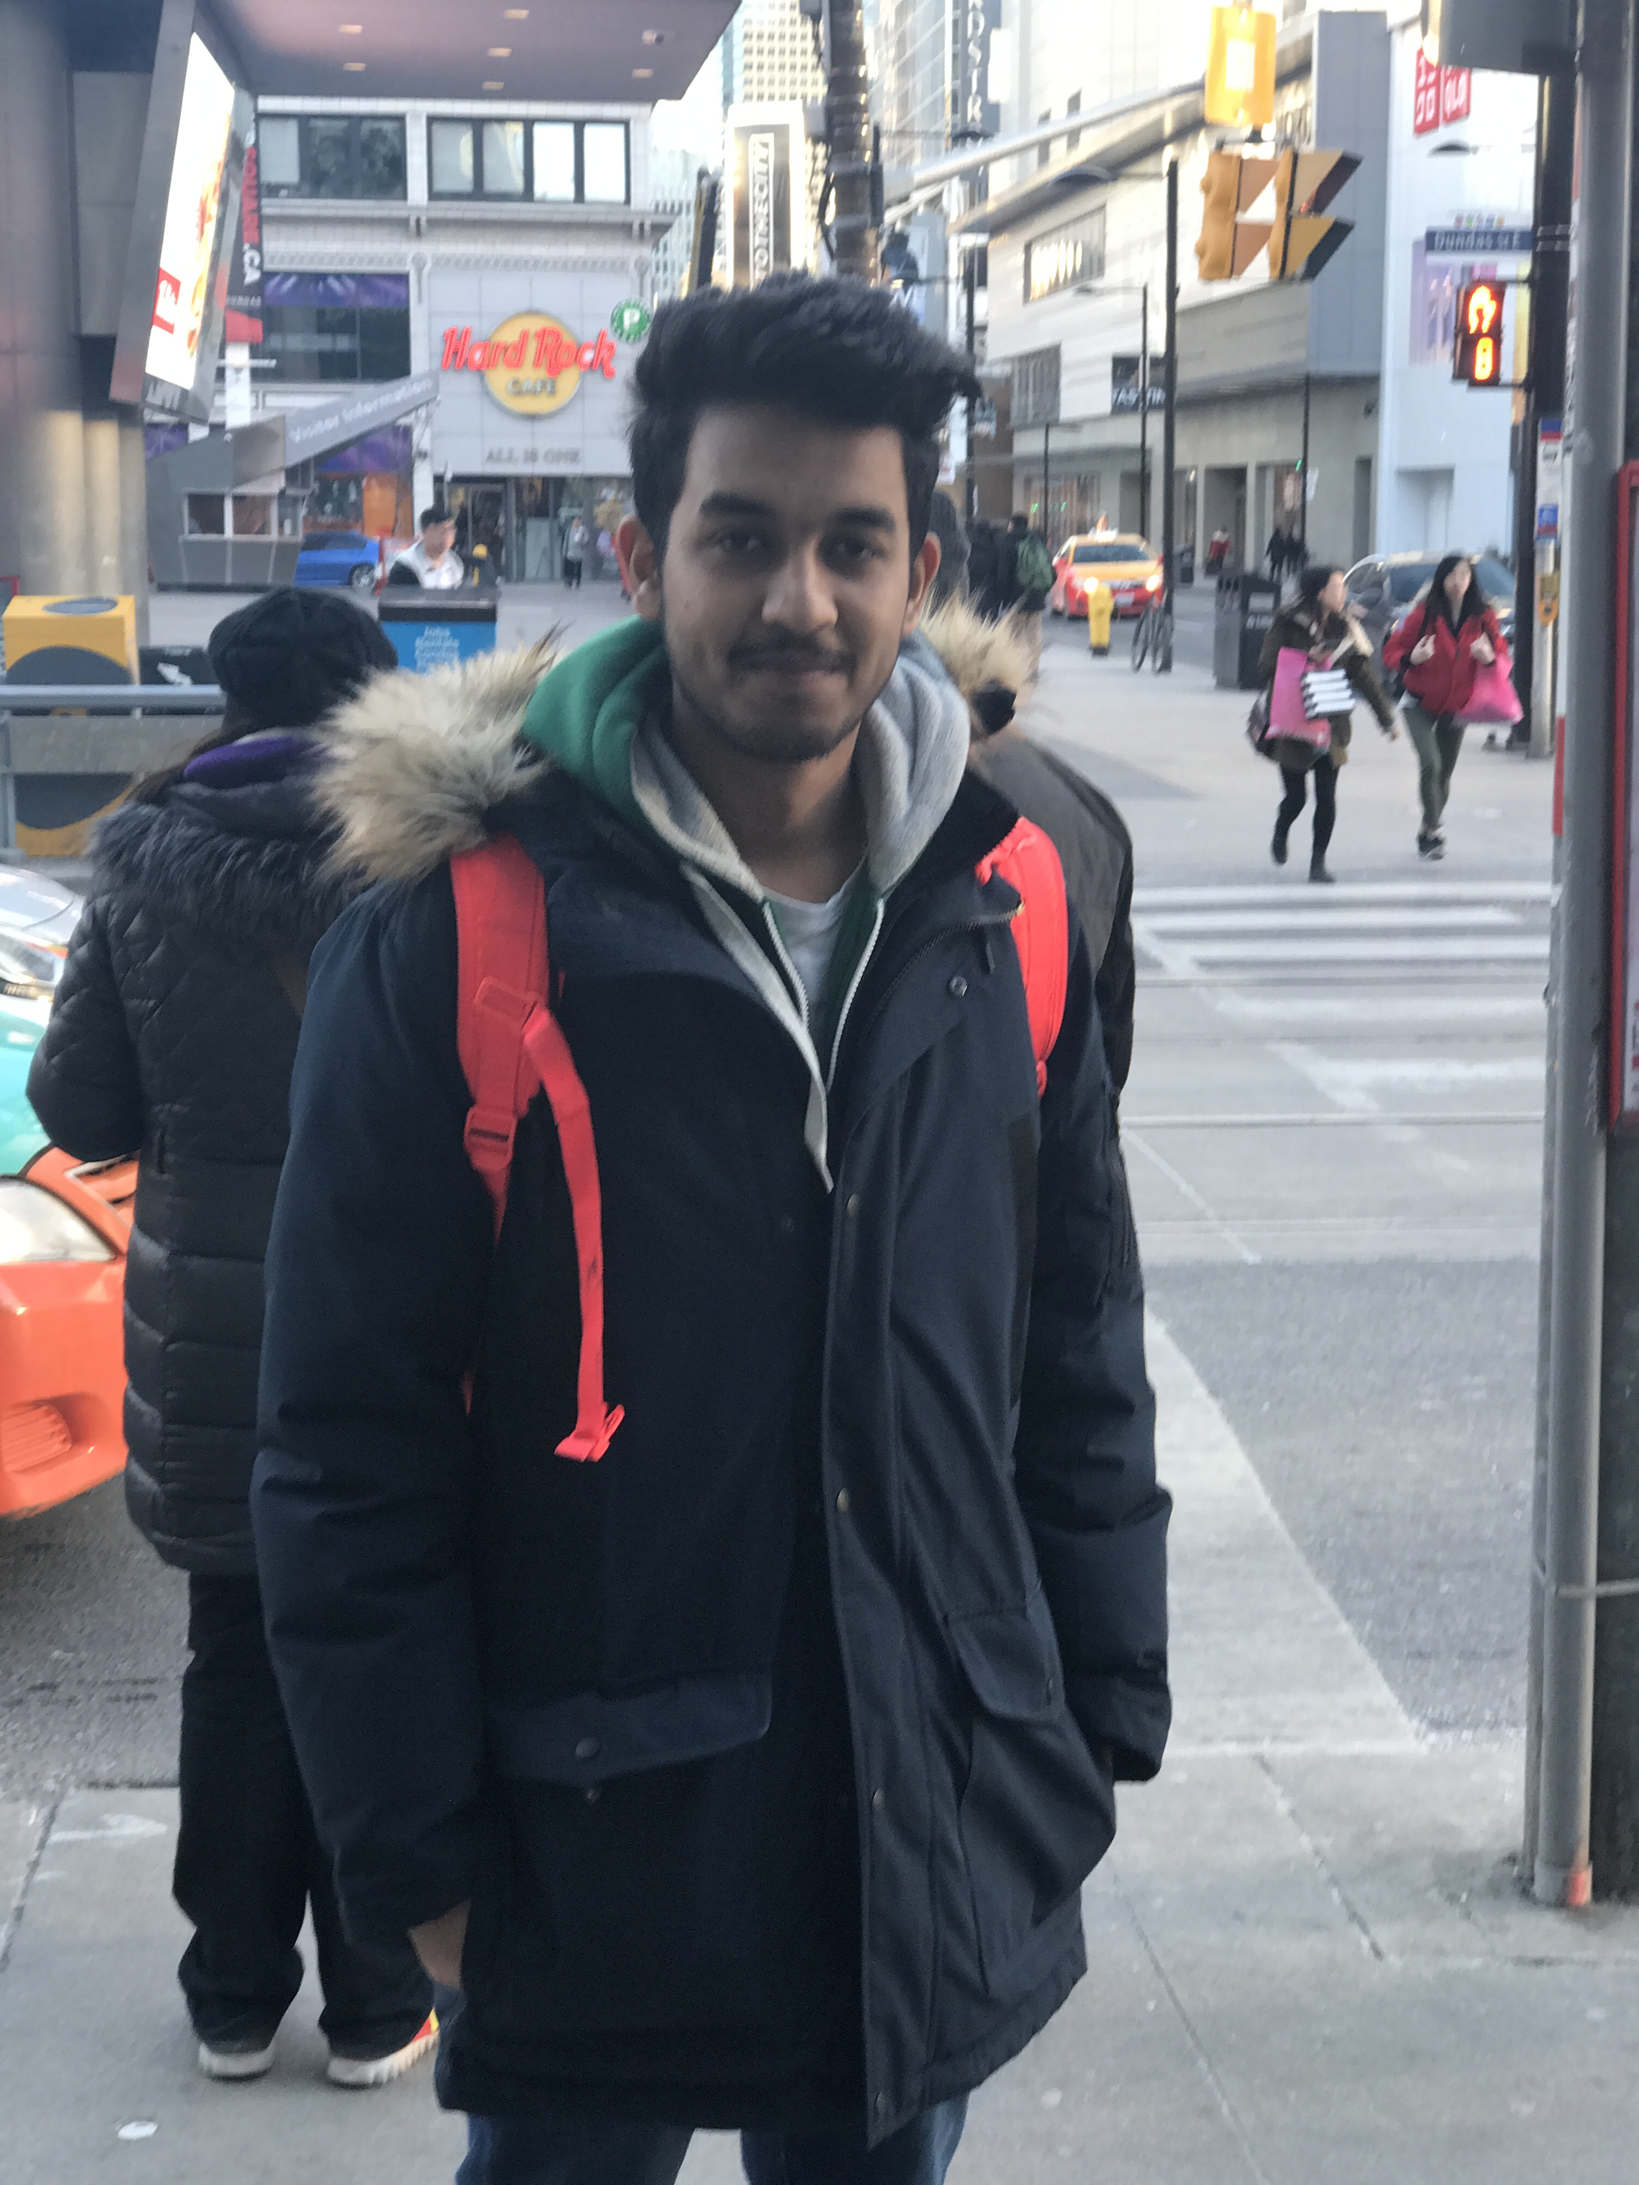

Team members
BHASKAR SHARMA
QA tester; Producer/ Project manager; Art Designer
SHAHIDRAJA RAJ
Software engineer, Game designer

Slide 3
Game Overview
Stella Laboratories were in the middle of their long awaited experiments on human beings, for an increased strength in human forms.
This is when the experiment goes wrong on Nova Sirius and he instead turns out to be someone much more stronger than what the scientists were working on.
Now, Nova has discovered his abilities and wants to escape, but when he does so, the alarm goes off…

Slide 4
Game Overview
The game revolves around Nova trying to escape the head scientist’s control.
During this course, we see the scientist attacking Nova in different ways, which he needs to defend making use of all the abilities that he has gained now.
The attacks go in the order of black bots, to the multicolored bots, that Nova can kill only with the respective colored bullets.
We also see that the bots contain the evil scientist’s energy, which keeps decreasing when the scientists releases them.

Slide 5
Game Overview
After Nova kills or saves himself from all the bots, he faces the evil scientist now.
In the end, the scientist is seen standing still, just waiting for being killed, because he has lost all his energy while he was releasing the bots.
You win the game when you ultimately finish the boss, helping Nova to escape the chamber and not letting Stella Labs take over the world.

Slide 6
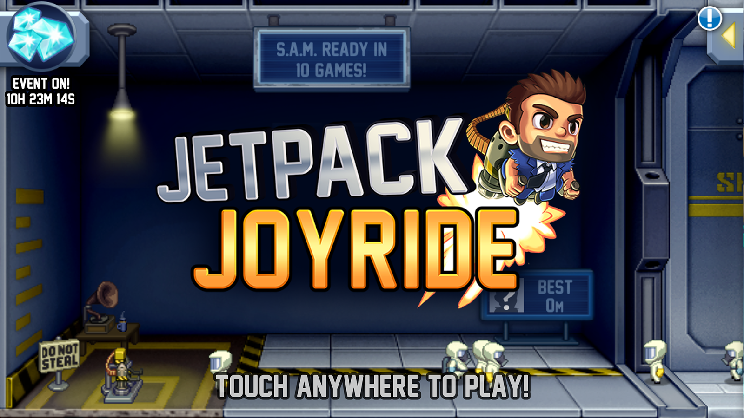
Game Overview
Our main idea for this project was to form a 2D Space Shooter Game.
And the concept behind it was inspired by the game Jetpack Joyride.

Slide 7
Game plan
We began the project as a group of 3 team members, but unfortunately one of our team members dropped the course and we became a pair.
This led to the re-planning of the entire game and the re-division of all the task from the scratch, right in middle of the semester, that too after the so called break.

Slide 8
Game plan
The increase in the difficulty per succeeding level.
This can be seen with different enemies in each level, and the game ending with the boss being part of the frame.
The introduction of new powers for Nova for each level.
This can be seen when Nova (and we) learn Nova’s bullet shooting skills in level 1, but we then learn in level 2 that he can also change his body colors and respective bullets.

Slide 9
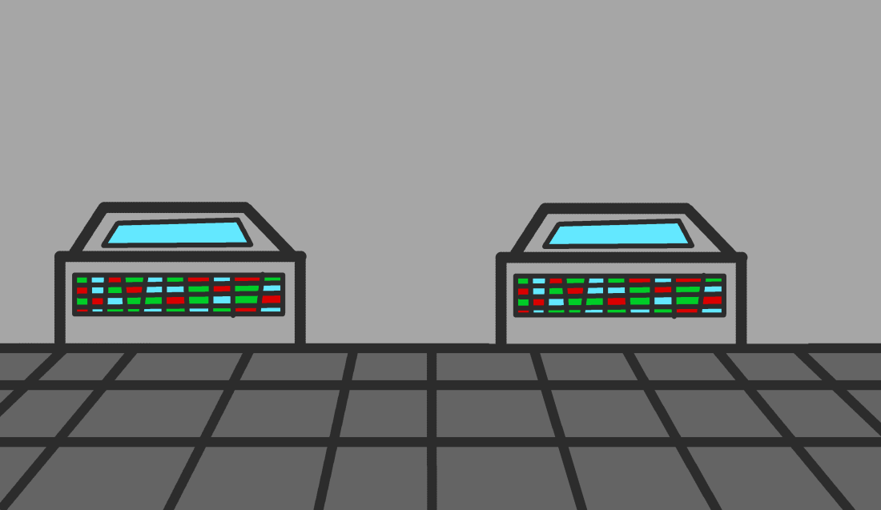
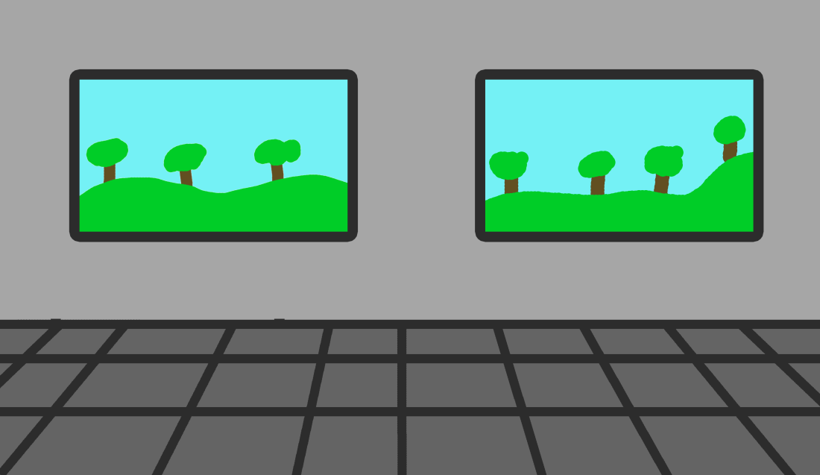
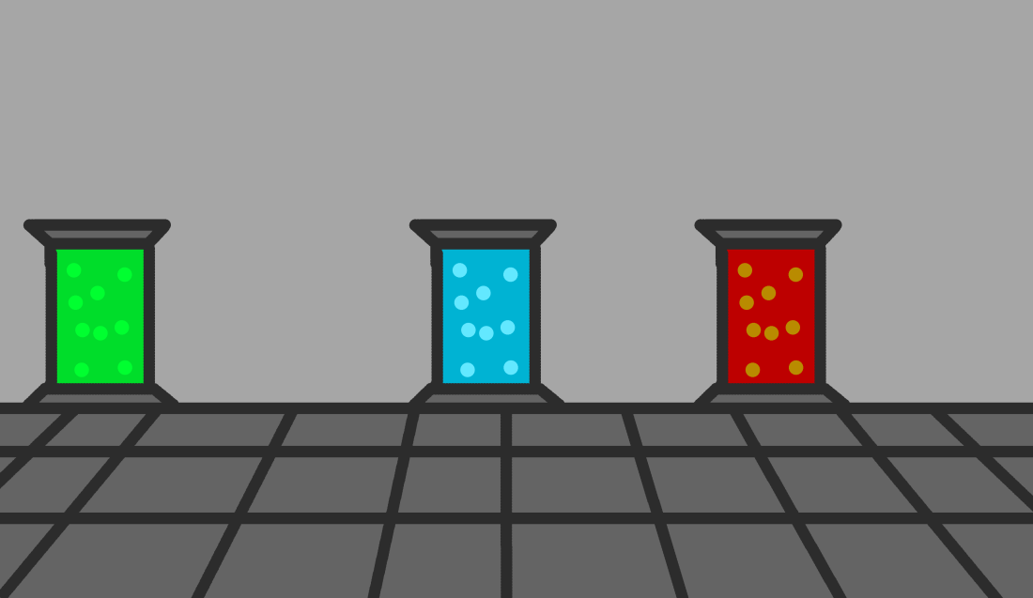
Game plan
Opening theme
Level 1 theme
Level 2 theme

Slide 10
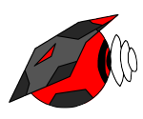
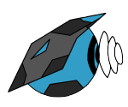
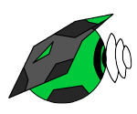
Game plan
Red Enemies
Blue Enemies
Green Enemies

Slide 11
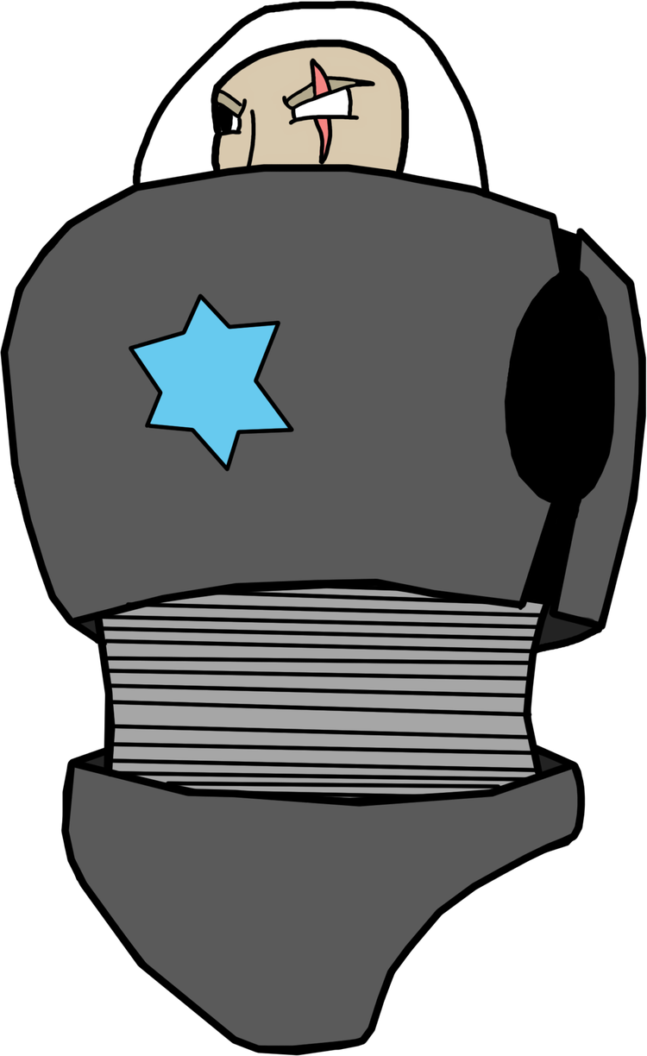


Game plan
Torso
Arms
Legs

Slide 12
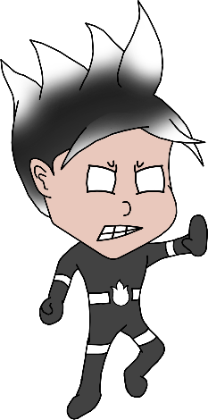
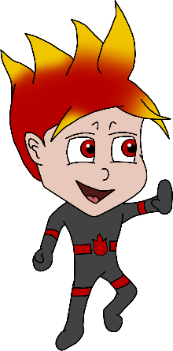
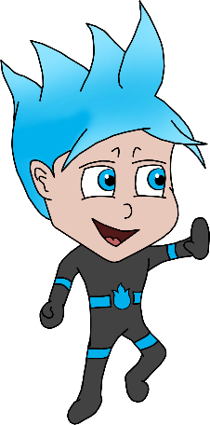
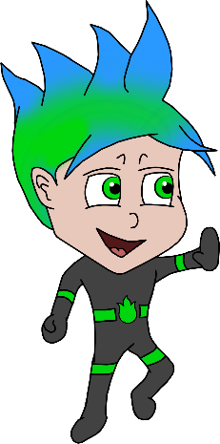
Game plan
Black Nova
Red Nova
Blue Nova
Green Nova

Slide 13
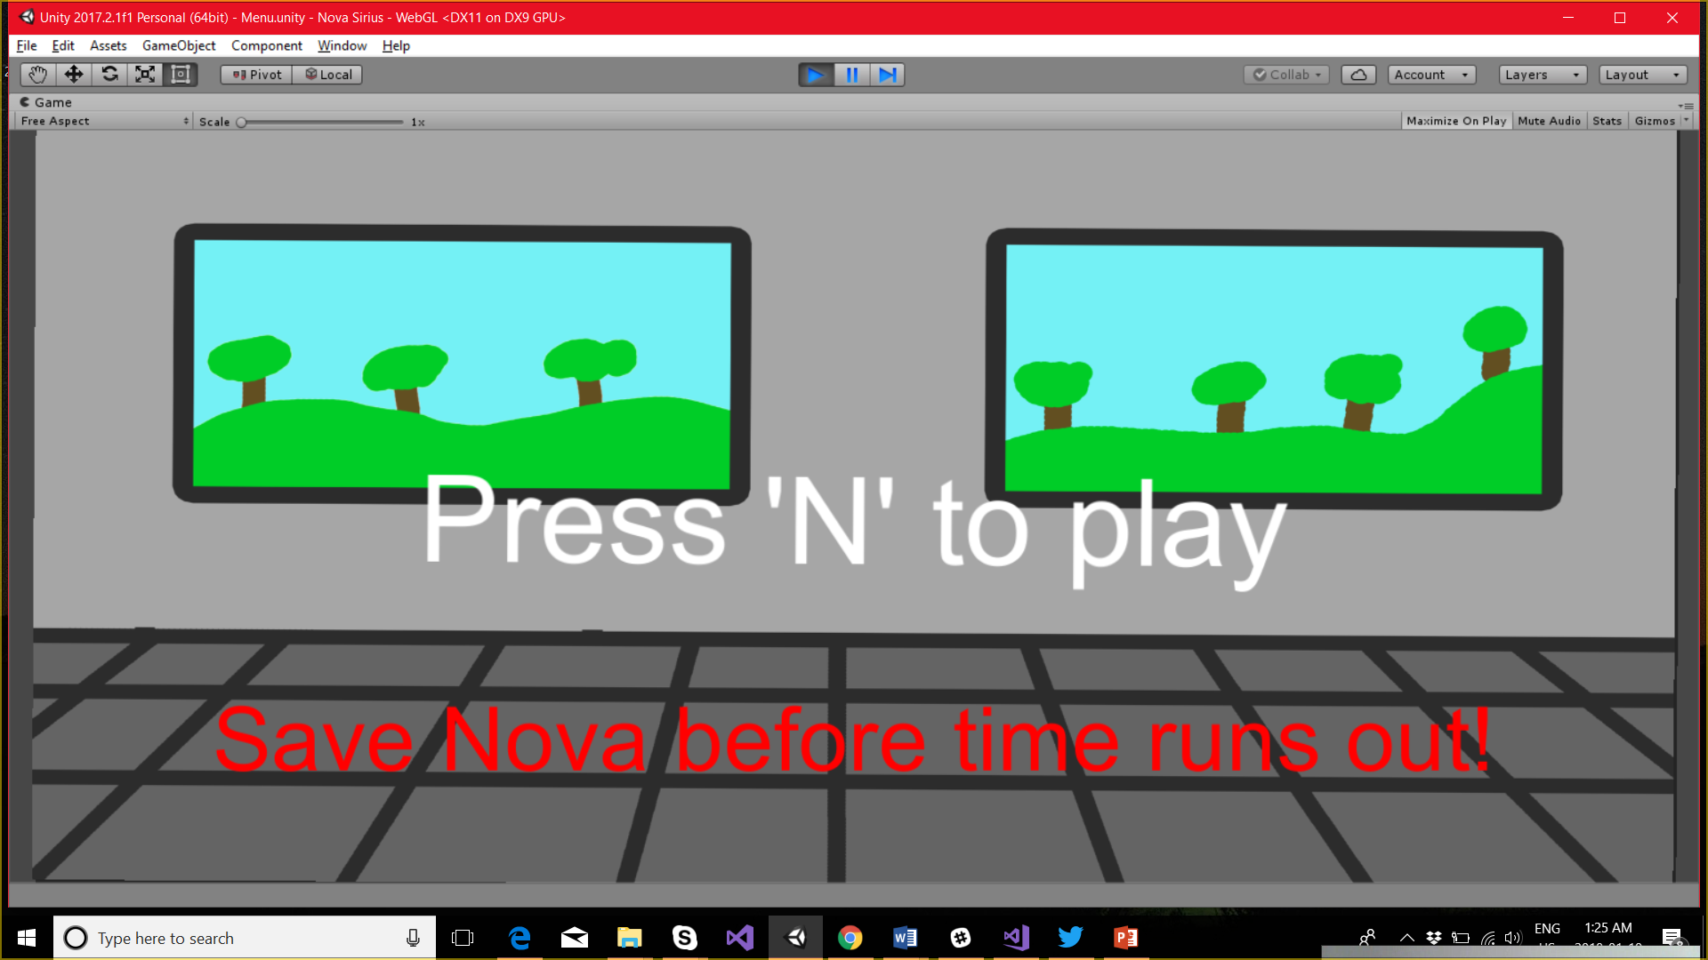
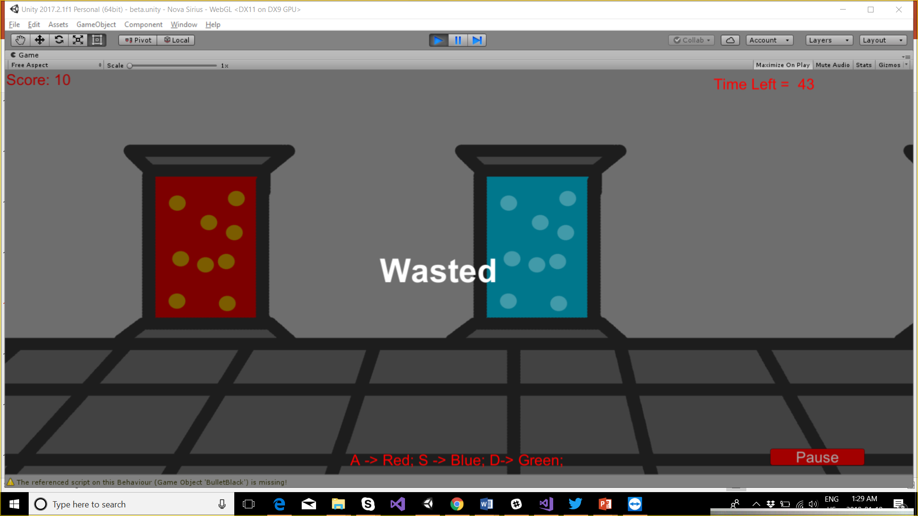
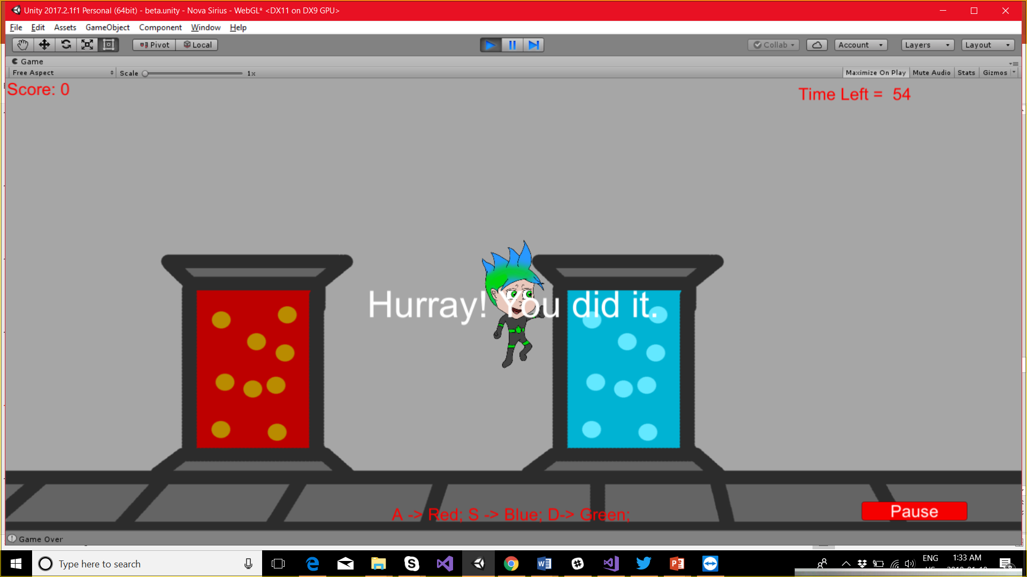
Game plan
Begin Game
Game Lost
Game Won

Slide 14
Game PLAY INSTRUCTIONS
Key things to remember:
Nova can fly – up, down, left, and right
Nova can shoot bullets of different colors and powers
Nova earns points with each bot that he hits
There is a limited time to help Nova, or else you lose the game!

Slide 15
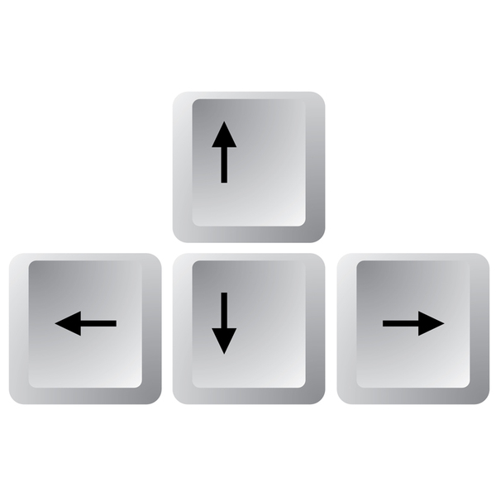
Game PLAY INSTRUCTIONS
to move up
to move left
to move down
to move right

Slide 16
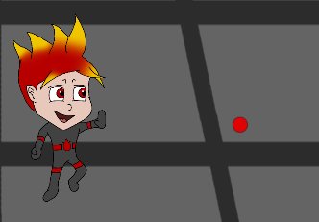
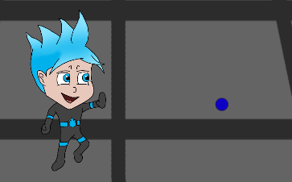
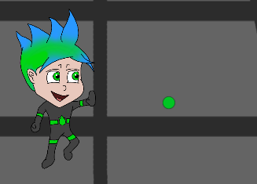
Game PLAY INSTRUCTIONS
‘A’ key to shoot Red Bullets
‘S’ key to shoot Blue Bullets
‘D’ key to shoot Green Bullets

Slide 17
Lessons Learned
We spent a lot of time in creating the game’s art, instead of focusing on its functioning as we later realized that the actual game play and its interaction with the player is always more important and necessary than the game art.
Similarly, we put more effort towards fulfilling the basic requirements of the project, rather than putting creative thinking in the front seat for the better outcome of our project.
Lastly, we learned that we should have the documented the design and the features of the game side by side, because that would have eased the process of representation in the later stages of the game.

Slide 18
Future Possibilities
Enemies: Enemies would also be able to shoot, they would be more stronger and more bullets would be required to kill the enemies.
Boss: Boss, in the second level can be killed by different bullets right now; but we would like to make it stronger per level, in such a way that the player would have to kill the boss using multiple bullets that too of different colors and powers.
Levels: We would want to add a third level where the enemies would spawn from any location, that is in front or back or the left or the right of the player.

Slide 19
Future Possibilities
Power-ups: There are several types of power-ups that we would like to add in the gameplay, when the player would earn a specific score/number of points; such as the ability to shoot multiple bullets at once or increase in the speed of the player.
Jetpack: The jetpack would be the most powerful feature for the player in the game. The jetpack would be placed on the player’s back with a fire animation underneath it that would help the player fly/jump high when wanted, in addition to the increased speed of the player.

Slide 20
DEMO

Slide 21
Thank You!

